Slide 1
1.6.8.1 Addition of complex numbers

Slide 2
Introduction
In this topic, we will
Define the sum of two complex numbers
See that
Complex addition is commutative
Complex addition is associative
0 = 0 + 0j is the additive identity

Slide 3
Review
Recall from secondary the following two sums:

Slide 4
Complex addition
Recall that , thus if
it follows that

Slide 5
Complex addition
Some examples:

Slide 6
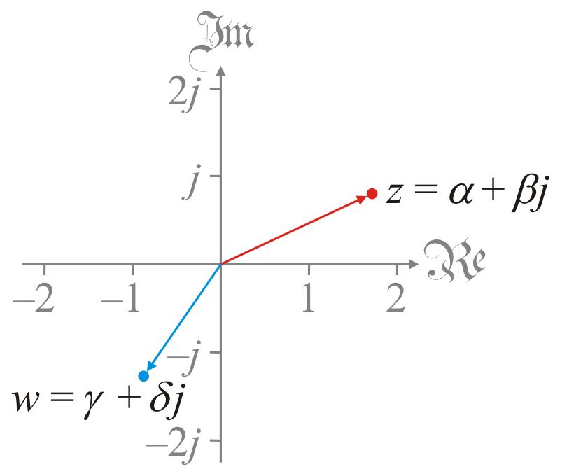
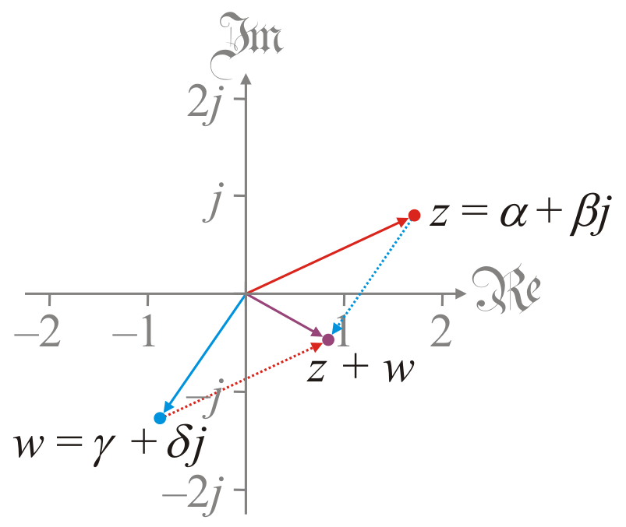
Complex addition
Going back to our geometric interpretation:

Slide 7
Commutativity
Theorem: Complex addition is commutative.
Proof: If
it follows that ,
QED

Slide 8
Associativity
Theorem: Complex addition is associative.
Proof: If
it follows that,
QED

Slide 9
The additive identity
Theorem: 0 = 0 + 0j is the additive identity.
Proof: If , then
QED

Slide 10
Important takeaways
The most important takeaways are
Adding complex numbers is almost as easy as adding reals
Given n complex numbers being added, you can add them in any order, and you’ll get the same result
For example,
(3.9 + 5.7j) + (1.8 – 8.6j) + (–0.5 + 3.4j) + (1.9 – 3.1j) + (3.9 + 8.4j) + (–6.4 + 1.5j) + (2.2 + 4.2j) + (4.1 – 7.0j)
equals 11.2 + 4.2j

Slide 11
Summary
In this topic, we’ve introduced complex addition
Very similar to polynomial addition
The geometric interpretation is straight-forward
We saw that
It is commutative
It is associative
0 + 0j is the additive identity

Slide 12
References
[1] https://en.wikipedia.org/wiki/Complex_number#Addition_and_subtraction

Slide 13
Acknowledgments
None so far.

Slide 14
Colophon
These slides were prepared using the Cambria typeface. Mathematical equations use Times New Roman, and source code is presented using Consolas.
The photographs of flowers and a monarch butter appearing on the title slide and accenting the top of each other slide were taken at the Royal Botanical Gardens in October of 2017 by Douglas Wilhelm Harder. Please see
https://www.rbg.ca/
for more information.

Slide 15
Disclaimer
These slides are provided for the ne 112 Linear algebra for nanotechnology engineering course taught at the University of Waterloo. The material in it reflects the authors’ best judgment in light of the information available to them at the time of preparation. Any reliance on these course slides by any party for any other purpose are the responsibility of such parties. The authors accept no responsibility for damages, if any, suffered by any party as a result of decisions made or actions based on these course slides for any other purpose than that for which it was intended.

